Slide 1
Disaster Recovery
Notes:
Mostly from Chapter 5 Risk Management
How risky is software development? According to Capers Jones’ database, the odds of a large project finishing on time are close to zero. The odds of a large project being canceled are 50-50.

Slide 2
Disaster Recovery Planning
Given a project which is in immediate danger of failing, the learner will
  identify the signs indicating imminent disaster
  describe the steps to take to recover the project.
Notes:
According to Jim McCarthy in Dynamics of Software Development, Microsoft Press 1995 Microsoft projects spend most of their time in project recovery mode. Look at McCarthy’s book as not what to strive for, but how one company handles continual disasters.
This is from Chapter 16
Have class read case study on p 372-373 to get the atmosphere, discuss what happened - were they aware it was a disaster?

Slide 3
Characteristics:
Failing Projects
People will not even guess at end dates
Product is full of defects
Extreme overtime, excess of 60 hours/week
Management loses control, unclear on status
Customer loses confidence in project delivery
Team feels threatened about their progress
Both sides considering cancellation
Morale lousy, project is no fun anymore
Notes:
Also relations between developers, marketers, managers, QA and customers are strained - all this is from Book
This is not a project that has slipped a bit!
At this point minor adjustments won’t work - strong medicine is needed.
Any class experience with such projects? Discuss
Are these projects in control or out of control?

Slide 4
General Recovery Options
Cut the size of the software
Increase process productivity
Slip the schedule
Drop a few features, increase productivity, slip schedule as needed
Real problem is how to finish at all
  focus on regaining control
Notes:
Time for decisive action - take no small measures.
It is easier to make big changes at one time then a death of a thousand cuts - lots of small corrections which do not correct the problem and go on for a long time.
Recall what types need for change

Slide 5
The Plan
Things to do first
People issues
Process issues
Product issues
Timing
This should look familiar from “four pillars of rapid development”
Notes:
cutting corners doesn’t work.
These topics are on next slides
Intended to help projects in deep trouble, strong medicine

Slide 6
Things to Do First
Assess the situation
  how critical is deadline?
  what is needed to meet it?
Look for win-win possibilities
  what is needed to succeed?
Mentally prepare to fix the project
Ask the team what needs to be done
Be realistic
Notes:
tough to be realistic - do not agree to deadline until you know how to get there, and it is in place.
Give a date by which you will have a new plan and dates in place.

Slide 7
People Issues
Restore team’s morale
Fix personnel problems
Fix leadership problems
Add people carefully
Focus people’s time
Allow people to have different styles
Make sure the team paces itself
Notes:
Morale: how to do? discuss
sacrifice a sacred cow - pay for dinner, get better equipment, allow time off for family
remove morale killers if possible
Eliminate problem people
Leadership problem may be management or technical lead. Can get new leader, or change role - change leaders boss, move leader into participatory role, provide leader with assistant
Focus - remove distractions, remove nonessential tasks
Styles - heroes and quiet workers
Pacing - avoid burnout with excessive schedule pressure

Slide 8
Process Issues 1/2
Identify and fix classic mistakes
Fix the parts of the development process that everyone knows are broken
Create detailed miniature milestones
Set up schedule linked to milestone completion
Track schedule progress meticulously
Record reasons for missed milestones

Slide 9
Process Issues 2/2
Recalibrate schedule after short time
Don’t commit to a new schedule too early
  wait until you can create a realistic one
Manage risks painstakingly
Notes:
Short time: 1-2 weeks

Slide 10
Product Issues
Stabilize requirements
Trim the feature set
Assess political position
Rework error-prone modules
Reduce the defects
  use an open defects graph
Get code to known state that works
  build on that

Slide 11
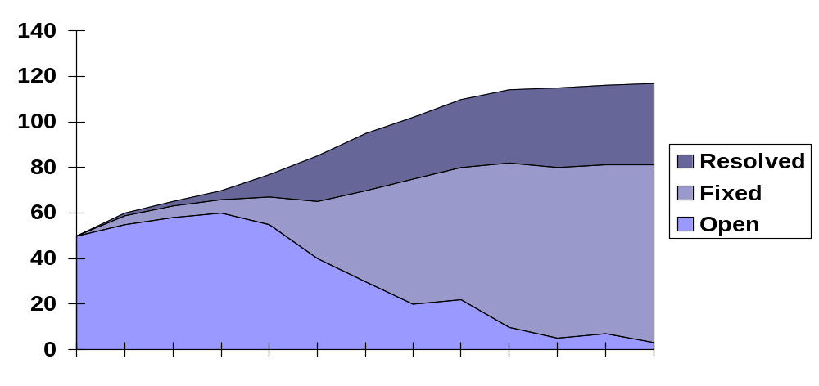
Open Defect Graph
Notes:
Goal to emphasize how many open defects there are, and highlight priority of reducing them
Bring to a low level and keep there
Use design and code reviews
Rework poor quality modules
Recall - focus on quality reduces integration time

Slide 12
Timing
Disaster recovery requires disaster perception
  desperation is required to rethink the whole project
  don’t get the reputation of a doomsayer
Disaster prevention is preferable to disaster recovery
  no fair creating disasters so you can rescue them

Slide 13
Conclusions
Better to avoid disaster recovery by good risk management
Disasters often caused by ignoring what is happening until it is too late
Easier to keep control than to recover control
Disaster is opportunity

